Slide 1





Empirio
Evidence Based Emission Reduction Advisor
Friedrich, Lasse
Echtermeyer, Eric
Brombach, Lukas
Q-Hackathon 2024 IBM Challenge
Prisett, Benedikt
Schaefer, David
Notes:
Data Fabric
Technical Integration layer
Can be used as a fundament of the Data Mesh
Makes data appear in the same way everywhere
Can be used as an interim solution between centralized and decentralized

Slide 2

Volker Wirsing Environmental clerk. Federal ministry of transport.
”How can I decide what to do based on the scientific status quo?”

Slide 3





Solution Architecture LLM based Agentic Workflow with RAG
Agent
Identify Areas
Identify Actions
Sector
RAG
GPT
Internet
“I have to decide...“
Keywords
Query
GPT 3.5
Mindmap
Embeddings

Slide 4
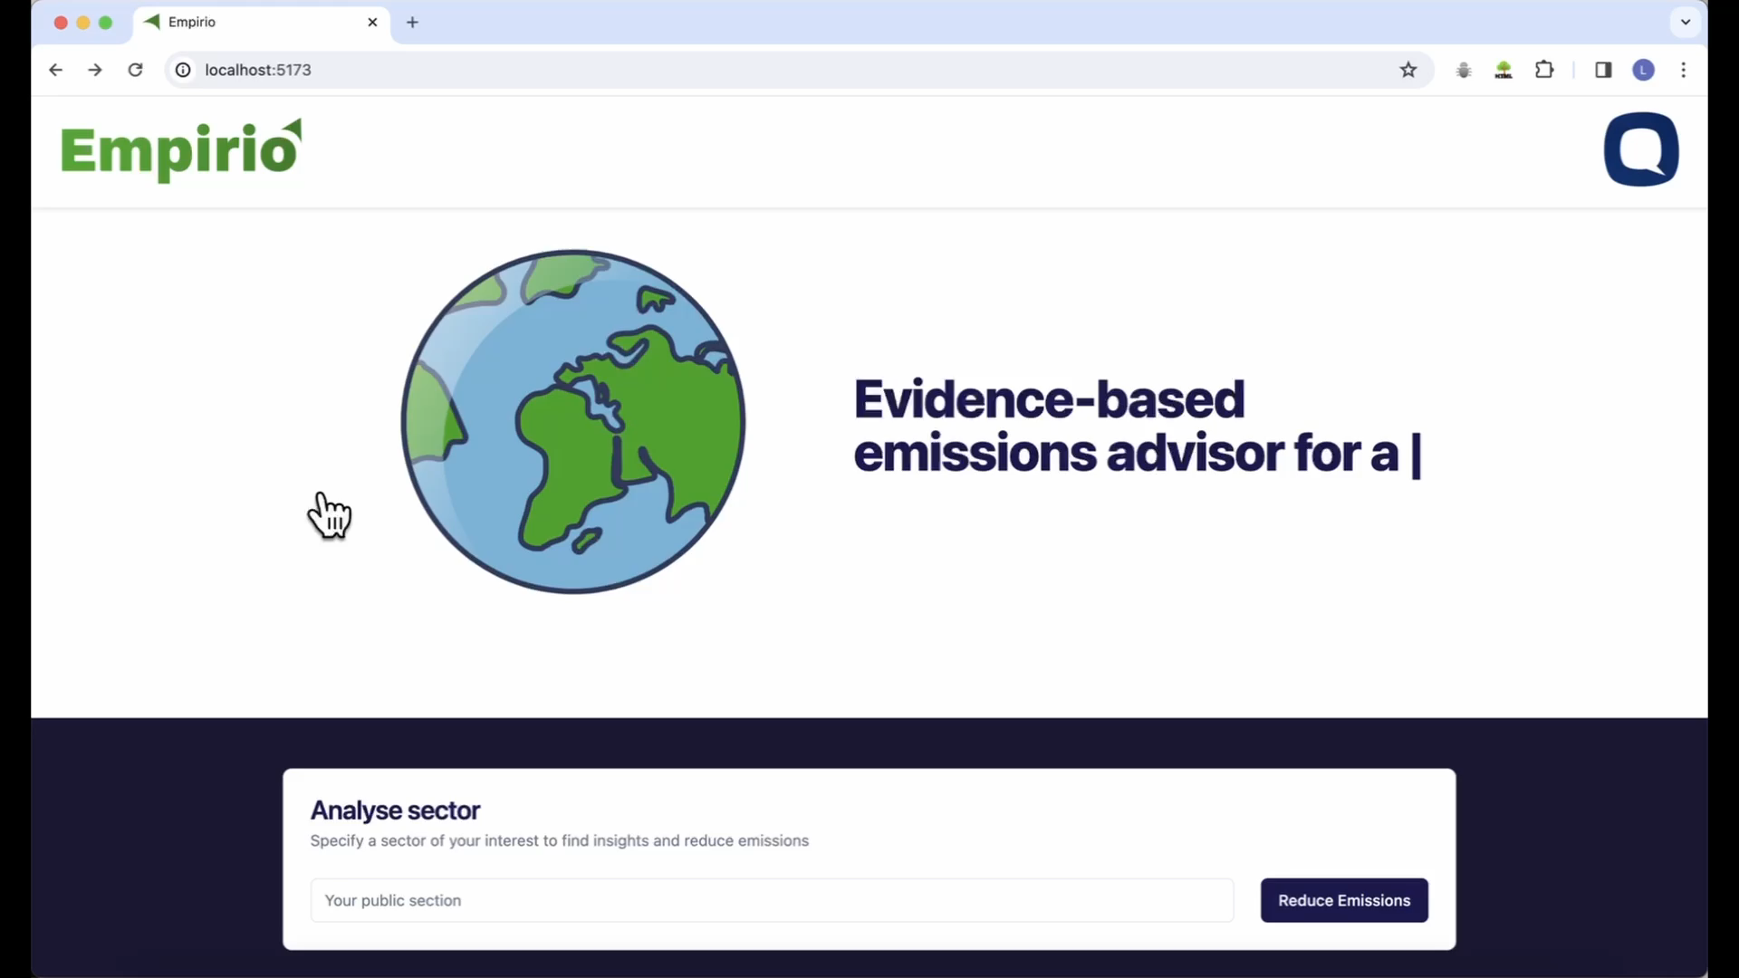
Demo

Slide 5



Future Development How can the solution be scaled?
Validate With Users
GPT 3.5
Expand Subject Coverage
Reach New Markets
Today
Q2 2024
Q3 2024

Slide 6
Evaluation Relevance put in numbers
271 Mio. €
Expenses In total for consulting services in the German federal departments for the year 2022 [1].
83%
Reduction Of average processing time within the specified task and setting. Measured by observing the performance of an internal team member.
GPT 3.5
Three
Unique Evaluation metrics for measuring effectiveness, scientific consensus and realization speed.

